Slide 1




Capstone Project SME Screen: Right First Applications

Slide 2
Table of contents
01
02
03
04
05
06
Introduction
Executive Summary & Project Scope
Solution Overview
System Architecture
Application Demo
Project Analysis

Slide 3
01
Introduction

Slide 4

Introducing the "Right-First-Time" Program
A new initiative to streamline the SME loan application process and reduce bounce rates.
Clear Requirements
Simplified loan application guidelines for applicants.
Simple Checklist
Easy-to-understand document checklist for all customers.
Clear Eligibility
Transparent eligibility parameters for SME loans.
Optimized Branch Time
Efficient use of branch resources during loan screening.

Slide 5


SpotCheck: The Future of SME Lending Gateway
SpotCheck is an intelligent, dual-interface platform designed to modernize the loan application lifecycle for Small and Medium Enterprises.
For Applicants: It is a smart, self-service portal that provides instant eligibility verification, guided document submission, and access to pre-matched lending opportunities.
For Lenders: It serves as a streamlined underwriting dashboard, offering real-time pipeline analytics and efficient queue management for rapid decision-making.
By digitizing the entire prescreening workflow, SpotCheck creates a transparent, efficient and digital-first experience for both borrowers and bank administrators.

Slide 6
02
Executive Summary & Project Scope

Slide 7

The Challenge: Incomplete Applications
SME customers often submit partial documents, leading to delays or rejections in loan processing.
Partial Submissions
Slower Processing
Customers frequently submit incomplete documentation.
Missing documents cause significant delays in loan appraisal.
Application Rejection
Incomplete applications are often rejected, frustrating applicants.

Slide 8
Executive Summary & Project Scope
1. Problem & Opportunity Statement
The Problem: Traditional SME (Small and Medium Enterprise) lending is plagued by manual inefficiencies. Applicants often submit incomplete documentation, and bank officers waste hours reviewing ineligible applications.
The Opportunity: By digitizing the "prescreening" phase, we can filter out unqualified leads instantly, ensure document completeness before a human reviews it, and significantly reduce the Turnaround Time (TAT) for loan processing.
2. Solution Requirements
Dual-Interface System: Secure, separate portals for Applicants and Bank Administrators.
Automated Validation: Instant logic checks for turnover, business age, and restricted sectors.
Document Management: Structured upload system for KYC, Income, and Business proofs.
Legacy Integration: Ability to match users against historical/pre-approved loan offers.
3. Executive Summary
SpotCheck is a full-stack web application designed to streamline the SME lending lifecycle. It empowers business owners with a self-service eligibility wizard and provides bank staff with a data-driven dashboard for rapid decision-making. The solution bridges the gap between raw application data and actionable lending insights.

Slide 9
03
Solution Overview

Slide 10




Pre-Screening Process: Initial Checks
Before full underwriting, applications undergo a crucial pre-screening based on key criteria.
SME Classification
Categorizing businesses by size and turnover.
Loan Eligibility
Assessing based on income and business nature.
Document Verification
Ensuring all required documents are present.

Slide 11
Solution Overview
1. Description
SpotCheck is a React & Node.js based platform. It features a "Smart Wizard" for new applications that guides users through eligibility criteria. It also includes a "Legacy Database" feature that uses the user's verified profile to instantly check eligibility for historical loan opportunities.
2. Design Considerations
User Experience (UX): Adopted a "Cozy Cream" theme (#fdfbf7) to reduce eye strain, moving away from sterile corporate white. Used distinct color coding (Indigo for Admins, Emerald for Users) for immediate role recognition.
Data Integrity: Implemented strict validation where Loan Amount cannot exceed Turnover, and specific documents are mandatory based on the entity type (Sole Trader vs. Company).
Scalability: The architecture separates the Client and Server, allowing them to be scaled independently behind an Nginx reverse proxy.
3. Use Cases
Applicant:
Check loan eligibility via the Wizard.
"One-Click Apply" for pre-matched Legacy Opportunities.
Revoke applications that are still under review.
Chat with "SpotBot" for instant support.
Bank Administrator:
Visualize total pipeline volume via Charts.
Approve or Reject applications with one click.
Monitor sector-wise demand.

Slide 12
SME Classification Criteria
Understanding the categories for micro, small, and medium enterprises.
Micro
Does not exceed 2.5 crore rupees
Does not exceed 10 crore rupees
Small
Does not exceed 25 crore rupees
Does not exceed 100 crore rupees
Medium
Does not exceed 125 crore rupees
Does not exceed 500 crore rupees

Slide 13
04
System Architecture

Slide 14
System Architecture
Architecture Flow:
User Access: Users access the platform via spot-check.site.
Reverse Proxy (Nginx): Routes traffic. Requests to / go to the React Client.
Requests to /api go to the Node.js Server.
Frontend (Client): Single Page Application (SPA) built with Vite & Tailwind. Handles UI logic and API calls via Axios.
Backend (Server): Express.js REST API. Handles business logic, file upload simulation, and session management.
Data Layer: SQLite database stores Application records and Legacy Data. It is file-based, ensuring easy backups and zero-configuration setup.

Slide 15
05
Application Demo
URL: https://spot-check.site

Slide 16
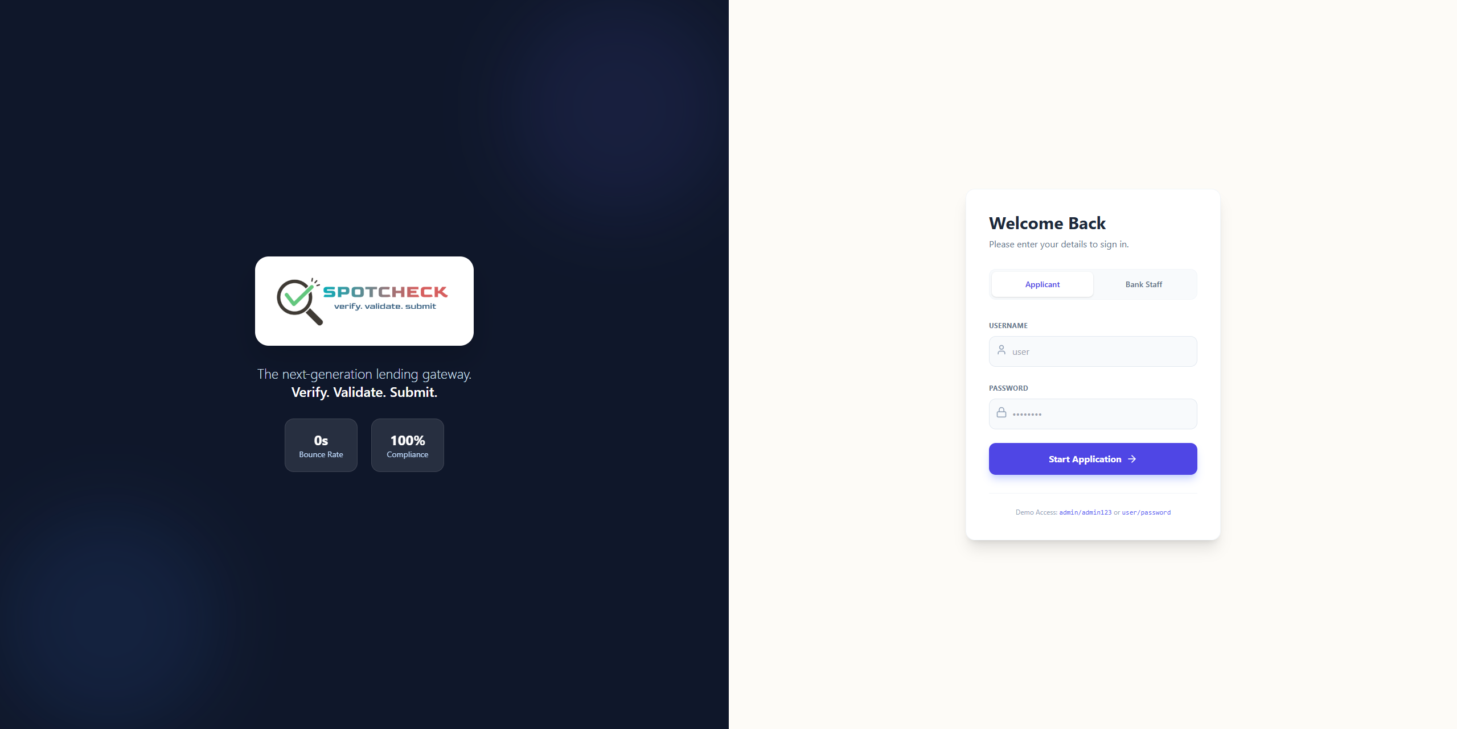
Application Demo
The Login Screen:
URL: https://spot-check.site

Slide 17
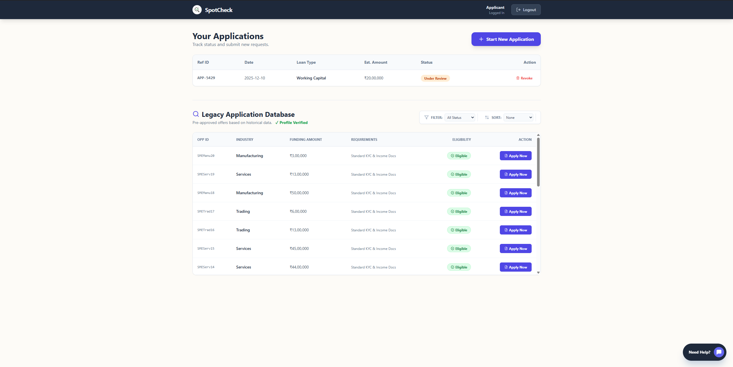
Application Demo
Applicant Dashboard:
URL: https://spot-check.site

Slide 18


KYC Checklist for SME Loans
Essential documents required for Know Your Customer verification.
1
PAN Card of Business
Mandatory for business identity verification.
2
PAN Card of Owners
Personal identification for all business owners.
3
Aadhar Card of Owners
Proof of identity and address for owners.
4
Business Office Address
Verification of the official business location.

Slide 19

Income Proof Requirements
Financial statements needed to assess the business's income stability.
P&L Statement
For 3 consecutive Financial Years.
Balance Sheet
For 3 consecutive Financial Years.
Income Tax Return
For 3 consecutive Financial Years.
Bank Statement
Business bank statements (last 6-12 months).

Slide 20


Business Proof Documentation
Documents verifying the legal existence and structure of the SME.
Government Issued Proof
Official registration documents.
Corporate ID Number
If applicable for the business entity.
Board of Directors List
Required for Private Limited businesses.

Slide 21
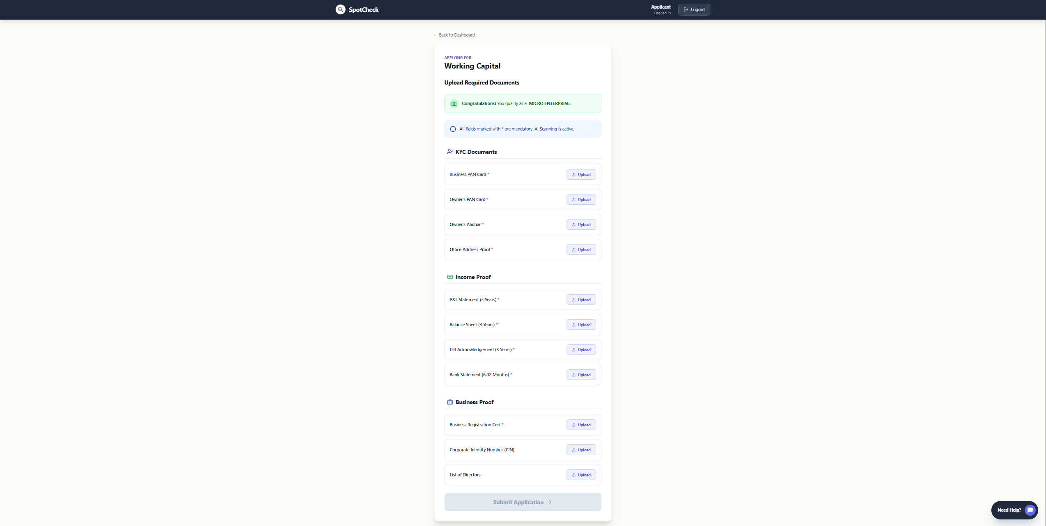
Application Demo
Document Upload Wizard:
URL: https://spot-check.site

Slide 22
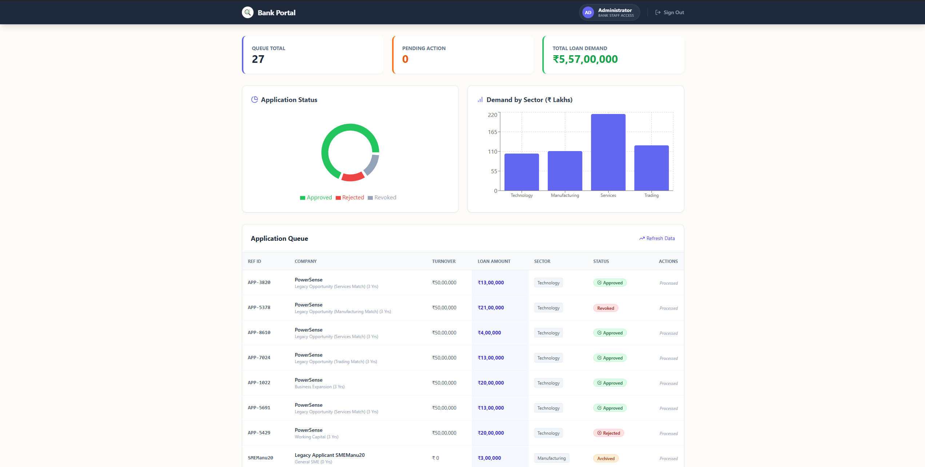
Application Demo
Admin Dashboard:
URL: https://spot-check.site

Slide 23
06
Project Analysis

Slide 24

Expected Outcomes: Enhanced Efficiency
The "Right-First-Time" program aims for smoother applications and reduced processing times.
50%
30%
20%
Reduced Rejections
Faster Approvals
Improved Customer Satisfaction
Streamlined process leads to quicker loan disbursals.
Fewer applications bounced due to missing documents.
Clearer process enhances applicant experience.

Slide 25
Project Analysis
1. Challenges Overcome
Complex Routing: Configuring Nginx to handle two different subdomains/ports on a Pterodactyl container environment.
State Management: synchronizing the "Latest Profile" state to enable the "Apply Now" feature for legacy apps without requiring re-entry of data.
Validation Logic: Implementing dynamic validation where document requirements change based on the "Legal Structure" selected.
2. Resources Found Helpful
Recharts Documentation: For implementing the responsive data visualization.
Tailwind CSS Docs: For rapid UI styling and custom color configuration.
SQLite3 Node API: For handling database transactions efficiently.
3. New Skills Used
Full-Stack Integration: Connecting a React Frontend to a Node/SQLite backend.
DevOps: Creating startup.sh scripts for container orchestration and configuring Nginx reverse proxies.
AI Simulation: Building a chatbot (SpotBot) with a keyword-matching engine.

Slide 26
Future Roadmap
OCR Integration:
- Replace simulated scanning with real Python-based OCR to extract data from uploaded PDFs.
Email Notifications:
- Integrate SendGrid/Nodemailer to alert users on status changes.
Database Migration:
- Move from SQLite to PostgreSQL for high-concurrency production use

Slide 27
Technical Stack (Prototype)
Frontend: React (Vite), Tailwind CSS, Lucide React (Icons), Recharts, jsPDF, Axios.
Backend: Node.js, Express.js.
Database: SQLite3.
Infrastructure: Docker (Pterodactyl Panel), Nginx.

Slide 28
Thank You!

